Slide 1
Integer Programming Modeling

Slide 2
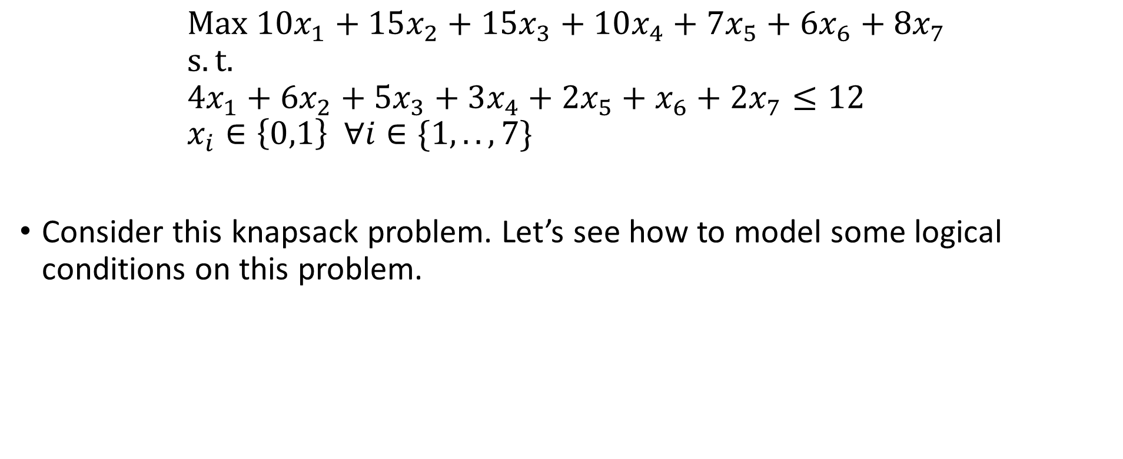
Example
$$Max {10x}_{1}+15x_{2}+15x_{3}+10x_{4}+7x_{5}+6x_{6}+8x_{7} \\ s.t. \\ 4x_{1}+6x_{2}+5x_{3}+3x_{4}+2x_{5}+x_{6}+2x_{7}≤12 \\ x_{i}∈\left\{0,1\right\} ∀i∈\{1,..,7\}$$
Consider this knapsack problem. Let’s see how to model some logical conditions on this problem.

Slide 3
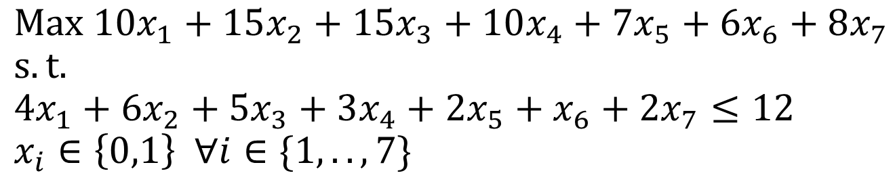
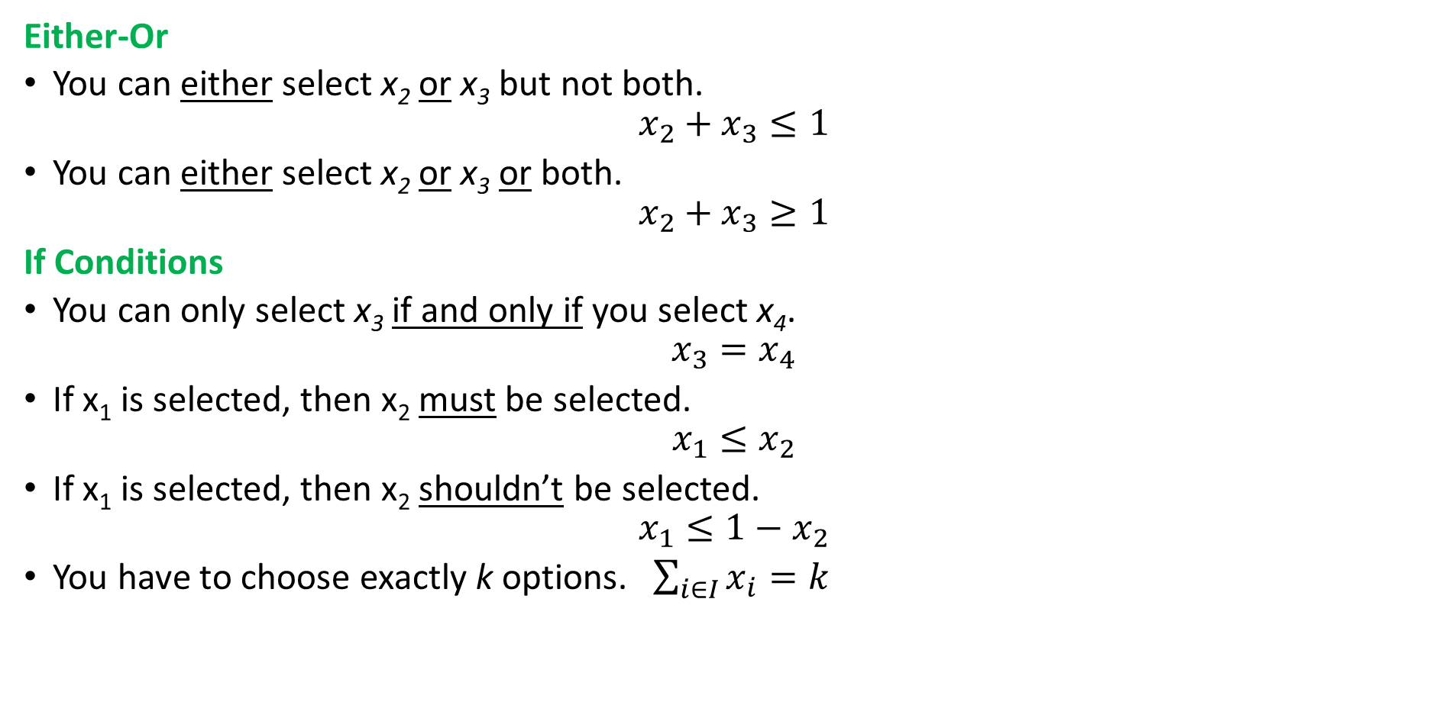
Logical Conditions
Either-Or
You can either select x₂ or x₃ but not both.
$$x_{2}+x_{3}≤1$$
You can either select x₂ or x₃ or both.
$$x_{2}+x_{3}≥1$$
If Conditions
You can only select x₃ if and only if you select x₄.
$$x_{3}=x_{4}$$
If x₁ is selected, then x₂ must be selected.
$$x_{1}≤x_{2}$$
If x₁ is selected, then x₂ shouldn’t be selected.
$$x_{1}≤{1−x}_{2}$$
You have to choose exactly k options. $\sum_{i∈I}{x_{i}}=k$

Slide 4
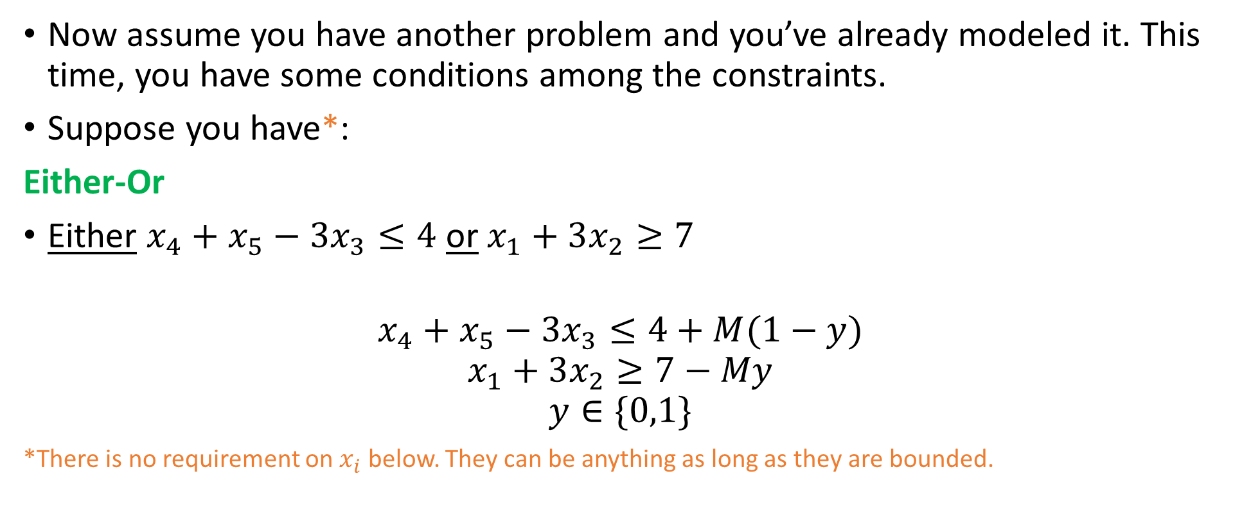
Logical Constraints
Now assume you have another problem and you’ve already modeled it. This time, you have some conditions among the constraints.
Suppose you have*:
Either-Or
Either $x_{4}+x_{5}−3x_{3}≤4$ or $x_{1}+3x_{2}≥7$
$$x_{4}+x_{5}−3x_{3}≤4+M(1−y)$$
$$x_{1}+3x_{2}≥7−My$$
$$y∈\{0,1\}$$
*There is no requirement on $x_{i}$ below. They can be anything as long as they are bounded.
Notes:
The idea is if y=1, the first constraint should be valid and if zero, the second one.

Slide 5
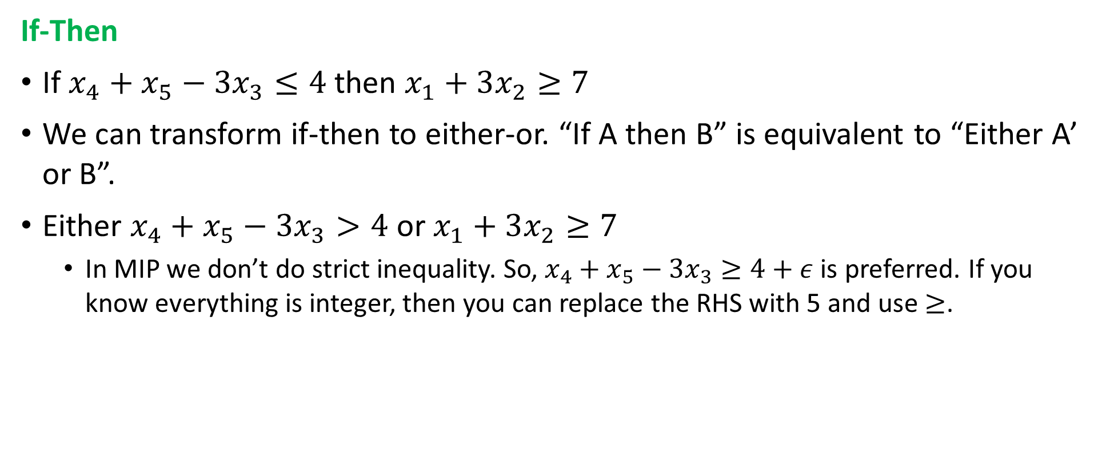
Logical Constraints
If-Then
If $x_{4}+x_{5}−3x_{3}≤4$ then $x_{1}+3x_{2}≥7$
We can transform if-then to either-or. “If A then B” is equivalent to “Either A’ or B”.
Either $x_{4}+x_{5}−3x_{3}>4$ or $x_{1}+3x_{2}≥7$
In MIP we don’t do strict inequality. So, $x_{4}+x_{5}−3x_{3}≥4+ε$ is preferred. If you know everything is integer, then you can replace the RHS with 5 and use $≥$.

Slide 6
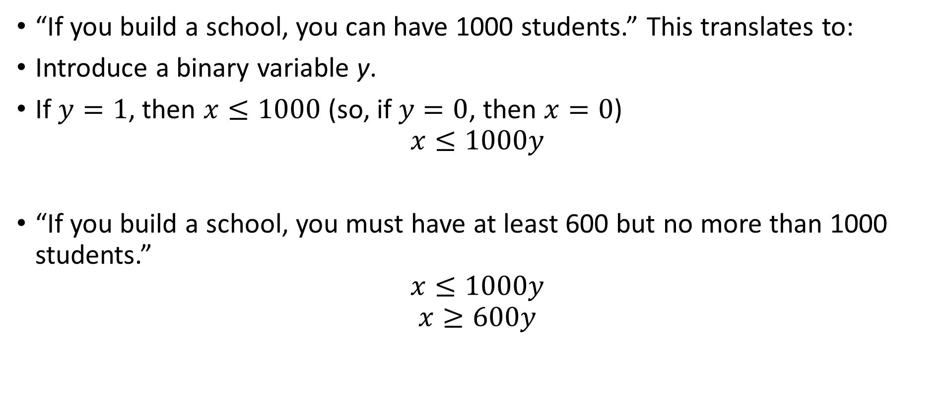
Fixed Cost
“If you build a school, you can have 1000 students.” This translates to:
Introduce a binary variable y.
If $y=1$, then $x≤1000$ (so, if $y=0$, then $x=0$)
$$x≤1000y$$
“If you build a school, you must have at least 600 but no more than 1000 students.”
$$x≤1000y$$
$$x≥600y$$
Notes:
If you heard “semi-continuous” variable, this is it (variable x)!

Slide 7

Some Linearization
Multiplication of Binary Variables
$z=xy$, x and y are binary
What is the result of this multiplication?
$z=0$ if either x or y are 0
$z=1$ if both x and y are 1
$$z≤x$$
$$z≤y$$
$$z≥x+y−1$$

Slide 8
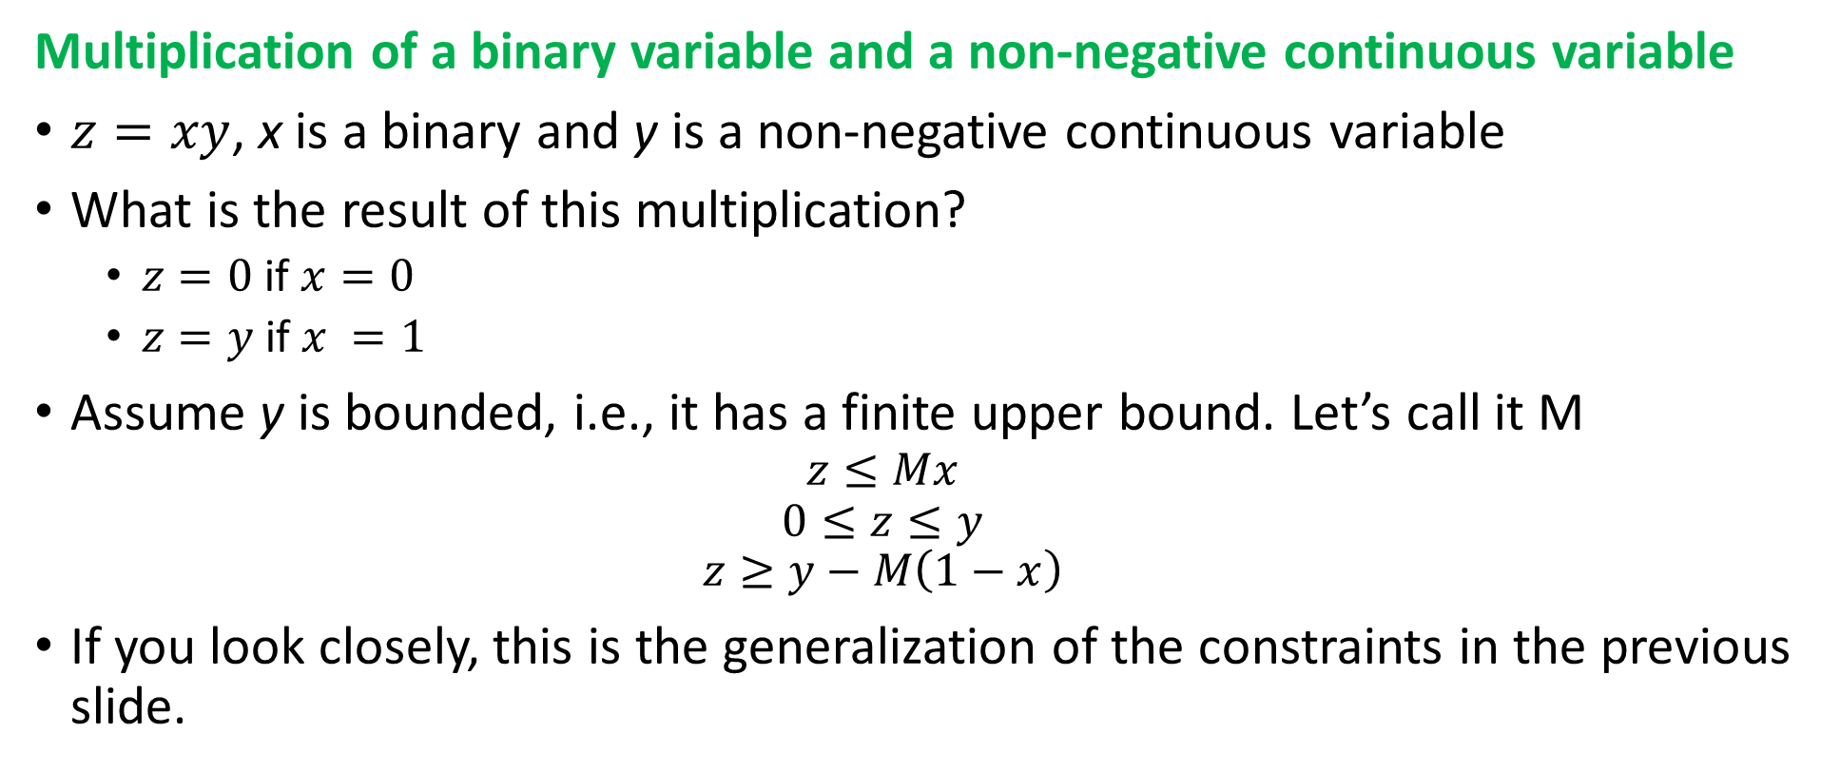
Some Linearization
Multiplication of a binary variable and a non-negative continuous variable
$z=xy$, x is a binary and y is a non-negative continuous variable
What is the result of this multiplication?
$z=0$ if $x=0$
$z=y$ if $x =1$
Assume y is bounded, i.e., it has a finite upper bound. Let’s call it M
$$z≤Mx$$
$$0≤z≤y$$
$$z≥y−M\left(1−x\right)$$
If you look closely, this is the generalization of the constraints in the previous slide.

